Slide 1
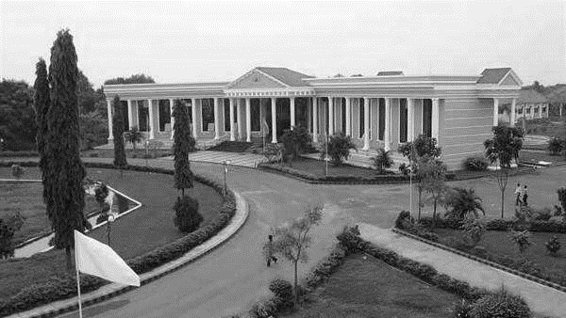



FILE ENCRYPTION AND DECRYPTION USING AES ALGORITHM
Presented By:
POTHYRAJAN S (510420104068),CSE,AEC
RAGUL S (510420104077),CSE,AEC
RAJESH M(510420104078),CSE,AEC
RAJESH SHARMA M (510420104080) ,CSE,AEC
Supervisor:
Mrs.D.KARTHIKA
ASST PROF, CSE,
ARUNAI ENGINEERING COLLEGE.
DEPARTMENT OF
CSE

Slide 2
ABSTRACT
The internet generates very large amount of data on a daily basis. While some of the information are trivial others are sensitive. As a matter of fact, the security of some information traversing the internet is critical to the survival of the owner. In this study, we implement the AES algorithm to produce a simple system for encryption and decryption of files with .txt extension. The system also incorporates digital signature to authenticate the sender of a message.

Slide 3
INTRODUCTION
Information is defined as a sequence of data that convey meaning to the person receiving it. It can be used to address the problem of decision making and reduces uncertainty. Information plays an important role in human life activities. Information distribution and accessibility have reduced the world to a global village. According to Meyer , information is usually exchanged face to face in an oral culture tradition. Information cannot be passed on a long distances and therefore it remains within a boundary of a particular community.

Slide 4
INTRODUCTION
Recent improvements in information technology, like the internet and electronic mail has made it possible for individual to exchange sensitive information across the globe with security. Internet, as a global interconnection of computers and computer networks, over the years is increasingly becoming an ubiquitous means for exchange of information, providing reliable and effective platform for communication, including conducting business remotely. For instance, information, in the form of text messages, computer files, to mention but two, can be exchanged via electronic mail, also known as email .

Slide 5
EXISTING SYSTEM
Designing an encryption/decryption system, amongst other things, requires decision on the basic functionality of the software, and the choice of cryptographic algorithm to be used. While the functionality supports the attractiveness of the system, the type of cryptographic algorithm actually determines how much security the system would actually provide. Hence, this forms the major component in the system design.

Slide 6
PROPOSED SYSTEM
The system shall be able to identify documents with .txt extension, for encryption. The system shall be able to generate public and private keys to be used by registered users for both encryption and decryption. The system shall be able to encrypt and decrypt text files stored in the computer system. The system shall be able to save the encrypted plain text as .txt files.

Slide 7
ADVANTAGES
High security
Attack is not possible.

Slide 8
TOOLS
MODULES AND DESCRIPTION
USER
FILE ENCRYPTION
FILE DECRYPTION

Slide 9
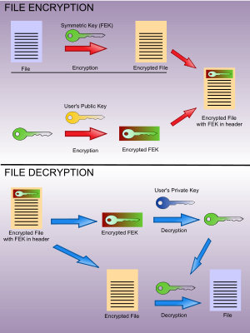
ARCHITECTURE DESIGN

Slide 10
SYSTEM TESTING
Software testing is a critical element of software quality assurance and represents the ultimate review of software specification, design and coding. The increasing visibility of software as a system element and the attendant “costs” associated with a software failure are motivating forces for conference management system project well planned, thorough testing. It is not unusual for conference management system project software.
TYPES
UNIT TESTING
INTEGRATION TESTING
VALIDATION

Slide 11
FUTURE SCOPE
In this paper we analyze that the process of encryption and
decryption is perform by using DES, AES and RSA
algorithms. In future we will apply and implement these
processes for secure and better communication.

Slide 12
CONCLUSION
Data encryption and decryption systems are used to improve information security to secure data that, thereby providing enhanced level of assurance such that the data that are encrypted cannot be viewed by unauthorized parties in the event of theft, loss or interception. This system replaces the existing data encryption and decryption system by adding some functionality such as digital signature. Future works could be devoted to scaling the system to be able to encrypt and decrypt other types of files, including audio, video, image, to mention but three.

Slide 13
REFERENCE
[1] X. Du, M. Rozenblit and M. Shayman, “Implementation and Performance Analysis of SNMP on a TLS/TCP Base,” in Proc. of The Seventh IFIP/IEEE International Symposium on Integrated Network Management (IM 2001), pp. 453-466, Seattle, WA, May 2001.
[2] B. Mada, M. Bagaa, and T. Taleb, “Trust-Based Video Management Framework for Social Multimedia Networks,” IEEE Trans. on Multimedia., vol. 21, no. 3, pp. 603-616, 2019.
[3] Y. Yu, Y. Li, B. Yang, W. Susilo, and G. Yang, “Attributebased cloud data integrity auditing for secure outsourced storage,” IEEE Transactions on Emerging Topics in Computing, DOI: 10.1109/TETC.2017.2759329, 2017.

Slide 14
THANK YOU
DEPARTMENT OF
CSE

